Slide 1
Influence of nativity and migration age on cognitive aging among Hispanic/Latino adults in the HCHS/SOL and SOL-INCA
William Dow, UC Berkeley
Thanks especially to co-authors:
Mao-Mei Liu, UC Berkeley
Ariana M. Stickel, SDSU
July 1, 2025

Slide 2
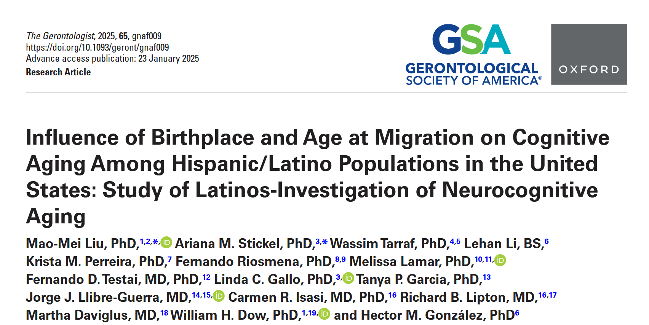

Slide 3
Disclosures, disclaimers…
No conflicts of interest to disclose
We will be using the term “Latino” throughout
Descriptions of data related to sex/gender will be in binary terms
Notes:
AMS

Slide 4
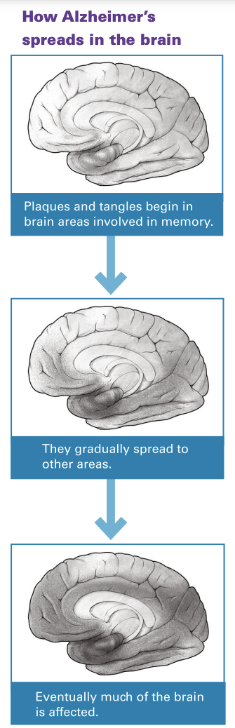

Background: Dementia
Dementia
Dementias are characterized by cognitive declines that result poor daily functioning
In 2018, U.S. dementia caregivers provided $233.9 billion worth of unpaid care (Alzheimer’s Association, 2019…Alzheimer’s & Dementia)
Alzheimer’s disease
Lewy body dementia
Vascular dementia
Frontotemporal dementias
AD Education & Referral Center, National Institute on Aging
Notes:
AMS

Slide 5
Background: Hispanic/Latino dementia risk
Hispanic/Latino individuals are projected to make up over 20% of the U.S. older adult population by 2060 (Census Bureau, 2021)
Hispanic/Latino adults are projected to have the largest increase in dementia cases by 2060 (Matthews et al., 2019…Alzheimer’s & Dementia)
Population growth + health disparities
Risk factors for dementia are not always the same across or within racial/ethnic groups (Granot-Hershkovitz et al. (2020)…Alzheimer’s & Dementia; Stickel et al., 2021…Frontiers in Aging Neuroscience)
Notes:
AMS

Slide 6
Background: age at migration
Migration is a major life course event which may affect health in later life (Alcántara et al., 2014; Sangalang et al., 2019; Torres & Wallace, 2013) but under-researched with regards to dementia
Age at migration allows us to operationalize a life course perspective of migration and health.
Healthy migrant hypothesis
Previous research on Hispanic/Latino adults’ birthplace/age at migration and cognitive aging have shown mixed results (Hill et al. 2012, Garcia et al. 2017, 2020)
Notes:
MML
- Migration is a major life course event with implications for socioeconomic status (SES), lifestyle modifications, and exposure to stressors—all of which may affect health in later life - , but it is quite under-researched with regards to dementia.
- Age at migration allows us to operationalize a life course perspective of migration and health.
- The Healthy Migrant hypothesis – that healthy migrants are selected into the United States – is influential.
- Individuals who migrate during childhood usually accompany their parents and so are not themselves likely to be selected for good health, but may gain late-life cognitive and health benefits from more years of education in the U.S. Younger age at migration is also linked to greater accumulation of wealth over the life course which then can influence cognition in later life.
- Individuals who migrate during young adulthood are more likely to be positively selected for good health and may still benefit from additional training and immersion in the destination labor market.
- Individuals who migrate during mid- and late adulthood may be less selected on health factors than the young adult migrants and less likely to gain additional training at their destinations relative to those migrating at younger ages. Previous research of Hispanic/Latino populations in the U.S. find that the risks of unfavorable health conditions like diabetes, obesity, and unhealthy behaviors increase with longer duration in the U.S. Existing studies also suggest that higher acculturation (e.g. language preferences, exposure and preferences in social settings, etc.) is associated with better cognition among Hispanic/Latino adults and earlier age at migration.
- Previous research on Hispanic/Latino adults’ birthplace/age at migration and cognitive aging have shown mixed results – some studies focusing on Mexican Americans show a cognitive testing advantage for individuals who migrated during mid adulthood (relative to US born) while the study using nationally representative sample of Hispanic/Latino find no such advantage. Each of these studies detect an overall advantage for foreign-born relative to U.S.-born individuals/

Slide 7
How are birthplace and age at migration related to cognitive aging?
Notes:
MML
In this paper, we ask:
- How are birthplace and age at migration related to cognitive aging among diverse Hispanics/Latinos in the U.S.?
- What (e.g., socioeconomics, demographics, health, acculturation, health behaviors) explains birthplace and age at migration differences in cognition aging?

Slide 8
Method
Notes:
AMS

Slide 9
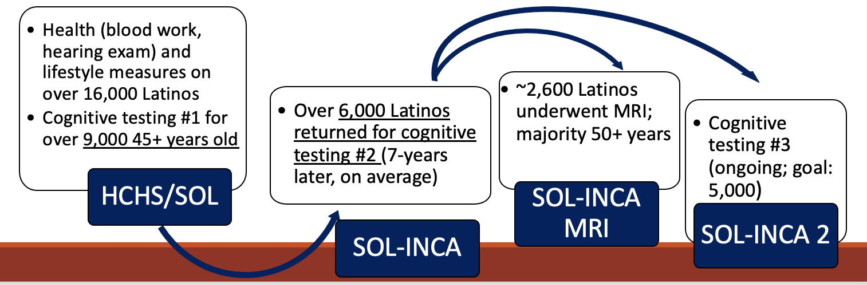
Participants
Notes:
AMS

Slide 10
Measures
Outcomes of interest: Cognition at Visits 1 and 2 and change in cognition from Visit 1 to 2.
Brief-Spanish English Verbal Learning Test (B-SEVLT) sum of learning trials and recall
Digit Symbol Substitution Test (DSS)
Word Fluency (WF)
Trails Making Test (A and B) *no cognitive change score
Global cognition
Exposures (Visit 1):
Birthplace/Age at migration (US born* (50 states + DC), <16 years, 16-34 years, >34 years)
*Island-born Puerto Ricans grouped by age at migration to mainland U.S.
Covariables**/domains (Visit 1):
Demographics (sex, marital status, heritage)
Socio-Economic (education, income, occupation, health insurance)
Acculturation (Short Acculturation Scale for Hispanics (SASH) social, SASH language, test language preference)
Health behaviors (self-reported sleep duration, diet, exercise)
Health (self-reported stroke/TIA, depressive symptoms)
Notes:
AMS

Slide 11
Statistical analysis
Survey linear regressions
US born group was reference
Crude and fully-adjusted
**Also included study site as a covariable in fully-adjusted models
Oaxaca-blinder tests
Allows us to quantify how each domain contributes to cognitive differences between the US born group and each age at migration group, separately
Notes:
AMS

Slide 12
Results
Notes:
MML

Slide 13
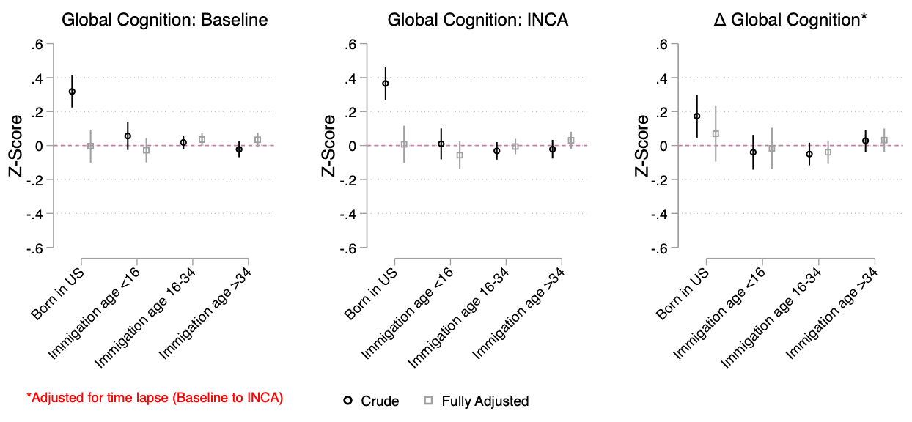
Age at migration and cognition
All foreign/territory-born Hispanic/Latino groups, regardless of age at immigration, have a cognitive performance disadvantage (at each Visit 1 and over time) relative to U.S.-born Hispanic/Latino adults
Differences do not endure with the inclusion of covariates
Notes:
MML
- Contrary to expectations, all foreign/territory-born Hispanic/Latino groups, regardless of age at immigration, have a cognitive performance disadvantage (at each Visit 1 and over time) relative to U.S.-born Hispanic/Latino adults.
- Differences do not endure with the inclusion of covariates

Slide 14
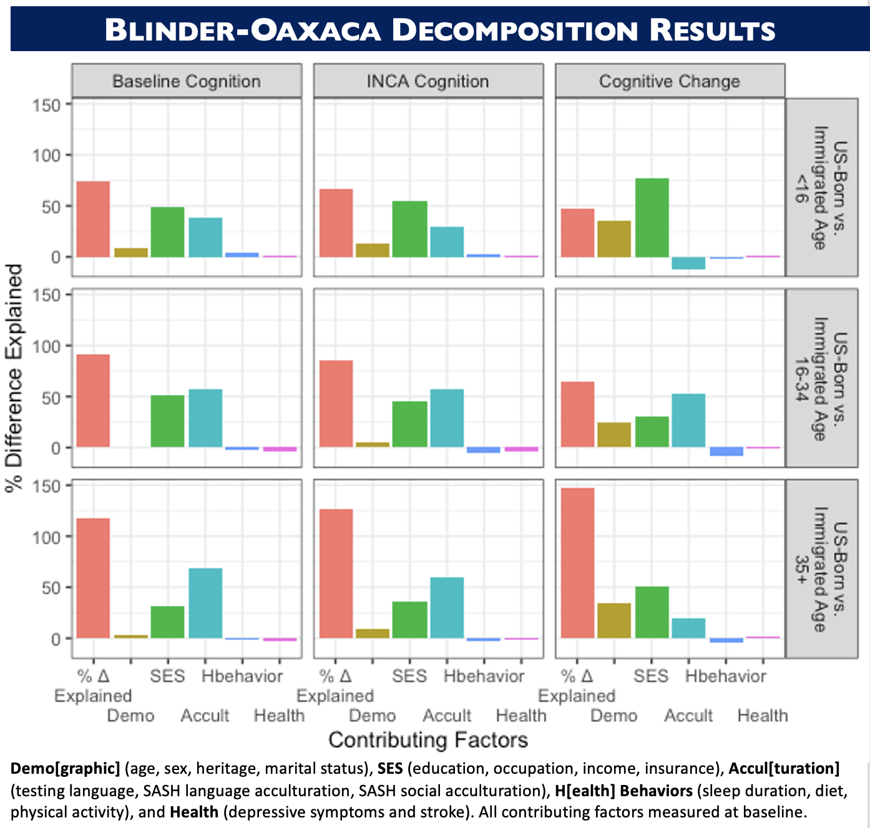
Age at migration and cognition
Differences are explained predominantly by Socioeconomic and Acculturation factors
Acculturation may play larger role in cognitive score differences among individuals who migrated in their late teens and adulthood
Notes:
MML
-Cognitive score differences based on migration status were explained by different factors, some of which shifted based on age at migration.
- Differences are explained predominantly by Socioeconomic and Acculturation factors
-Acculturation may play larger role in cognitive score differences among individuals who migrated in their late teens and adulthood
-Self-reported health and health behaviors contributed little to cognitive score differences between migrants and US born Hispanic/Latino adults.
-Socioeconomic factors appeared to impact cognitive aging regardless of regardless of age at migration.

Slide 15

Future directions
Genetics, physiology, and physical health
Brain health
Examine the combined associations among heritage, race/color, age at migration, and cognition
Investigate specific factors (e.g. bilingualism) that may connect acculturation to cognitive aging.
Include other markers of SES (e.g. home ownership) and change across life course
Culture and lifestyle
Cognition
Notes:
MML

Slide 16
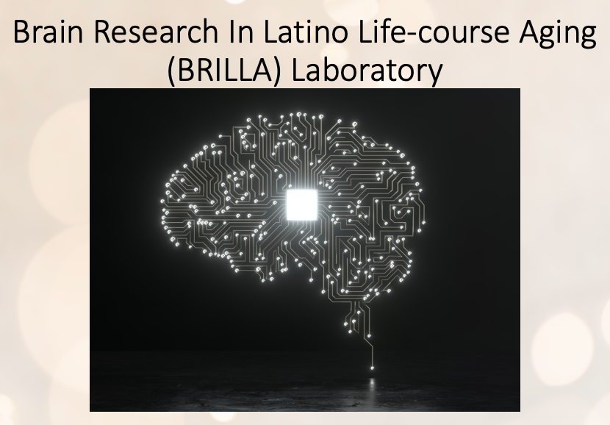

Acknowledgements
Special thanks to Dr. Wassim Tarraf and Lehan Li for performing the data analysis
Dr. Dow & Dr. Liu receive support from NIA grant R01AG064778
Dr. Stickel supported by NIH grants K08AG075351, L30AG074401, and U54CA267789
HCHS/SOL & SOL-INCA:
SOL-INCA/MRI is supported by NIA grants P30AG059299, R01-AG048642, RF1 AG054548 and RF1 AG061022
HCHS/SOL is funded through NHLBI contracts N01: HC65233, HC65234, HC65235, HC65236, HC65237

Slide 17

Questions

Slide 20
HCHS/SOL Short Acculturation Scale for Hispanics (SASH) social and language subscales
Social Subscale (4 items)
1. Your close friends are…
All Hispanic/Latino
More Hispanic/Latino than non-Hispanic/non-Latino
About half and half
More non-Hispanic/non-Latino than Hispanic/Latino
All non-Hispanic/non-Latino
2. You prefer going to social gatherings/parties at which people are…
3. The persons you visit or who visit you are…
4. If you could choose your children’s friends you would want them to be…
Language Subscale (5 items)
Although you may speak many languages, the following questions refer to only English and Spanish.
1. In general, what language(s) do you read and speak?
Only Spanish
Spanish better than English
Both equally
English better than Spanish
Only English
2. What was the language(s) you used as a child?
3. What language(s) do you usually speak at home?
4. In which language(s) do you usually think?
5. In general, what language(s) are the movies, T.V. and radio programs you prefer to watch and listen to?

